Slide 2

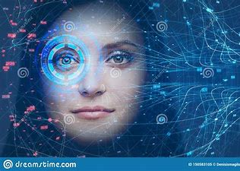
ATTENDANCE USING FACIAL
RECOGNITION
By:
Rohit raj & Abhishek kumar

Slide 3
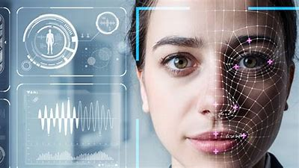
WHAT IS FACE RECOGNITION?

Slide 4
Face Recognition is a branch of AI that can uniquely identify a person by analyzing known patterns
It can analyze a picture and recognize the faces in it
Face Recognition technology can be as good or even better than humans in determining whether two photographed images are of the same person.

Slide 5
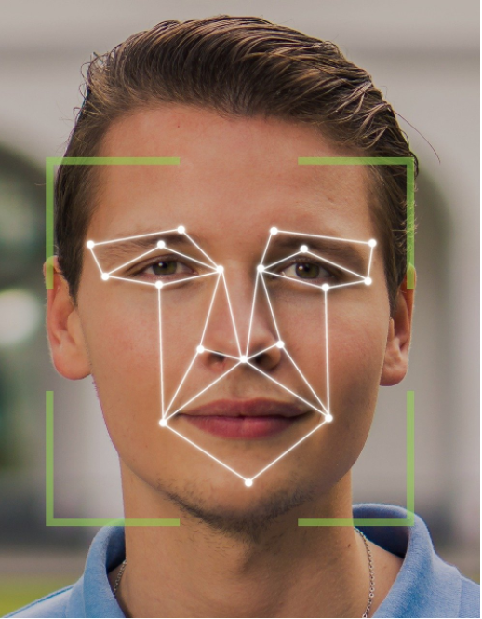
HOW FACE RECOGNITION TECHNOLOGY WORKS ?

Slide 6
First, your face is captured with a photo or video
The software then measures a variety of facial features called landmarks or nodal points on the face
These could include the distance between the eyes, the width of the nose, depth of eye sockets, distance from forehead to chin.
This information is then converted into a mathematical formula which represents your unique facial signature
That facial signature is then compared to a database of known faces

Slide 7
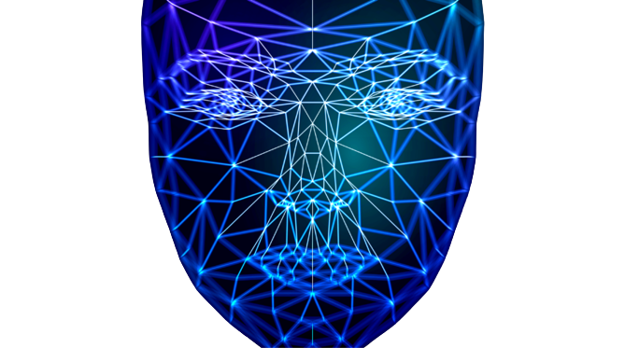
USAGE OF Face Recognition technology

Slide 8
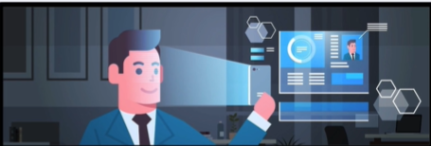


To verify valid users
To diagnose diseases
Control access to private areas

Slide 9
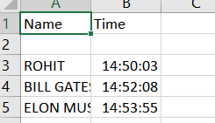
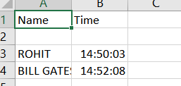
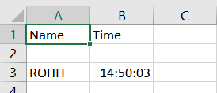
Attendance project
We have used the powers of AI to make an attendance project, which uses Face Recognition to recognise faces through a webcam, in real time.
When the program detects a face, it compares the facial signature to a data base of known faces and marks the name & time on an Excel sheet at the same time.

Slide 10
Tools & packages used
Python
NumPy
OpenCV-Python
CMake
Dlib
Face-Recognition library

Slide 11


THANK YOU
MEET THE TEAM
Rohit Raj
Abhishek Kumar

Slide 12
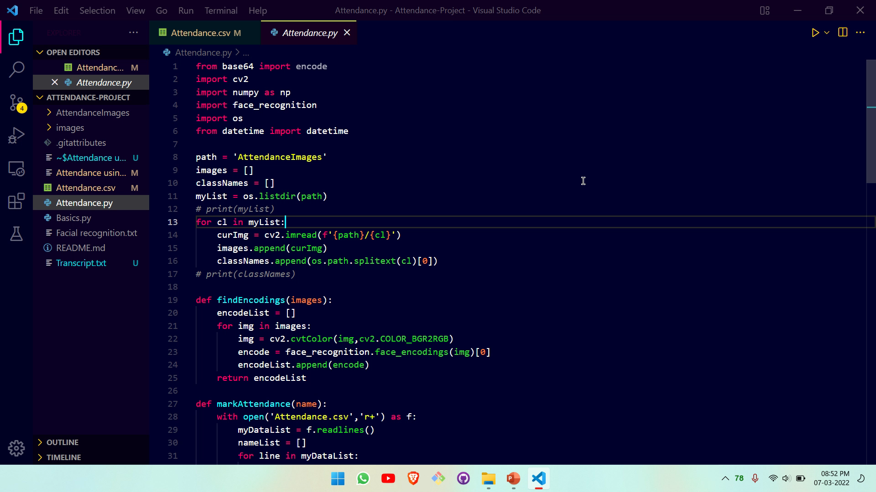

Slide 13
Refrences
Machine Learning is Fun! Part 4: Modern Face Recognition with Deep Learning | by Adam Geitgey | Medium
https://www.youtube.com/watch?v=cCeUdTXZJHs&t=137s
https://www.youtube.com/watch?v=sz25xxF_AVE&t=362s

